Slide 1
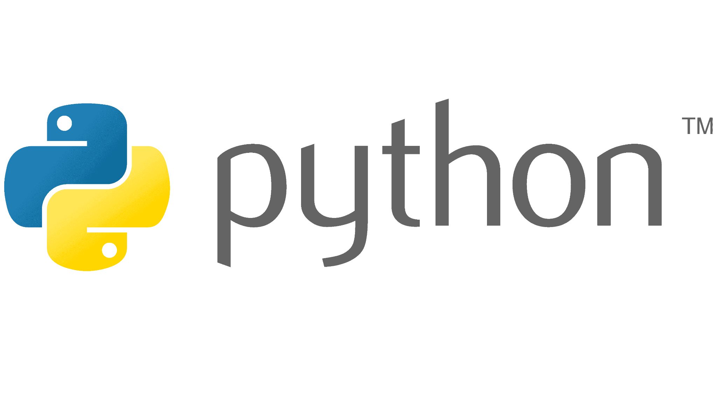


Slide 2

Last lecture reminder
We learned about:
How to use boolean variables in conditions
What are arrays in Python and when we need to use them
How to create, update and delete element in Python array
What are methods and properties
How to work with arrays methods (sort, filter, index, append, etc… )
How to access properties and methods
How to use functions as parameters and variables

Slide 3


Slide 4
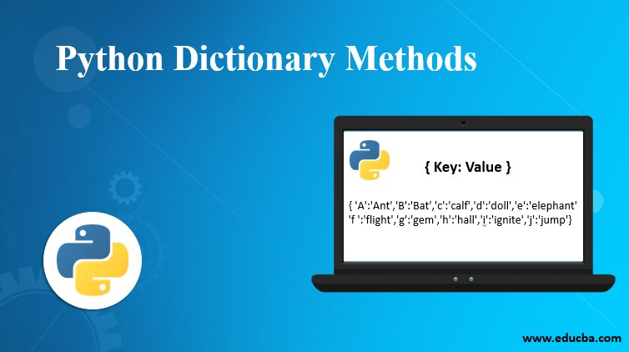

Slide 5
What are objects in Python?
As we discussed, in our day to day life, everything around us can be defined as an object.
For example: a ball is an object → our ball has its own shape, color, size, texture and more.
Each of those values can be represent as key - value pairs or properties, and we can have a lot of objects of type “ball” but they all will be different from each other because of their own properties. Because Python is also an OOP programing language (Which we learned on what it is later in the course) we can represent an object with class, or with a dictionary.

Slide 6
What are objects in Python?
So, just like in real life, in Python (and in almost all of the programming languages) we have the ability to create our own objects.
For each object we can:
Add its own properties
Add its own methods
Save it to a variable and use it where ever we want
Pass it to a function as a parameter

Slide 7
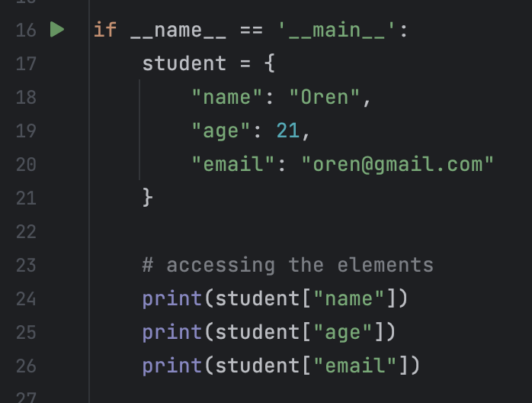
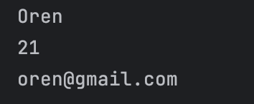
Python objects syntax
By using the {} symbol we are declaring on a new dictionary.
Inside the {} block we can add our properties in key - value pairs:
First - the property name also called “key” or “name”
Second - the property value
We are setting properties for our object named “student” as key-value pairs
By using the [] (just like in arrays) we can get access to all the values of the pass keys and use them

Slide 8
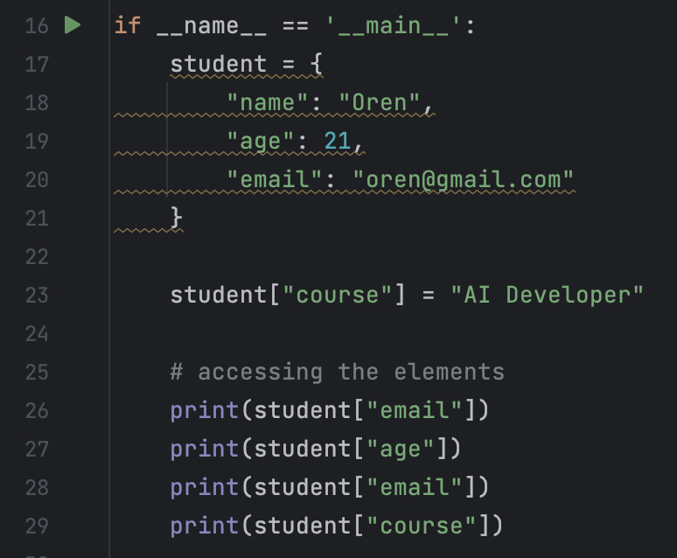
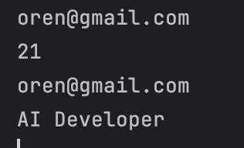
Add key-value to an dictionary
If we will want to add new key-value to an already existed dictionary we can do it by provide the key-value pair that we want to add.
For example:
add new key-value pair to the “student” object

Slide 9
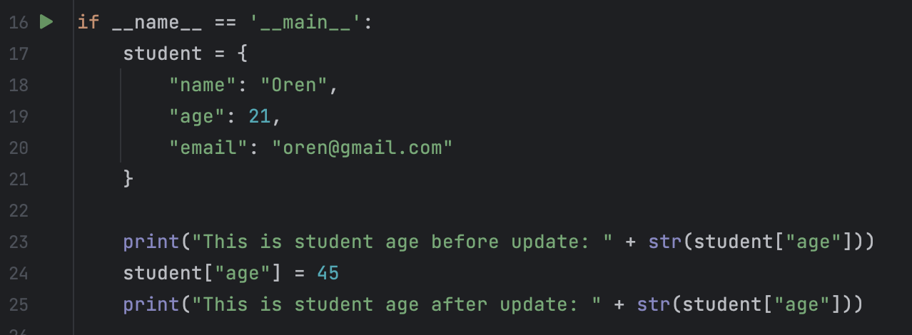
Update key-value in a dictionary
If we will want to update our dictionary, meaning replace a value in an existing key, we should follow the same logic. Just provide the key that you want to replace it’s value and the new value you want to replace it to.
Note: A specific key name in an object can be created only once. What it means is that if we will add the same key with a different value, Python will override the existing value of that specific key.
For example:
“Add” an already existing property key so Javascript will override its value with the value we provided

Slide 10
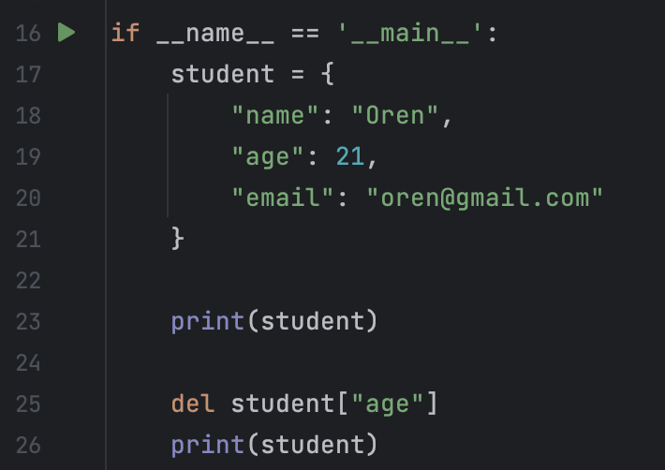
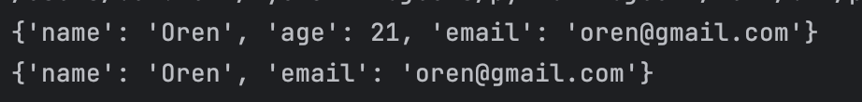
Delete property from an object
If we will want to remove a specific property from an object we should use the del keyword and provide the relevant property name we want to remove.
For example:
using the del keyword to remove a specific property

Slide 11
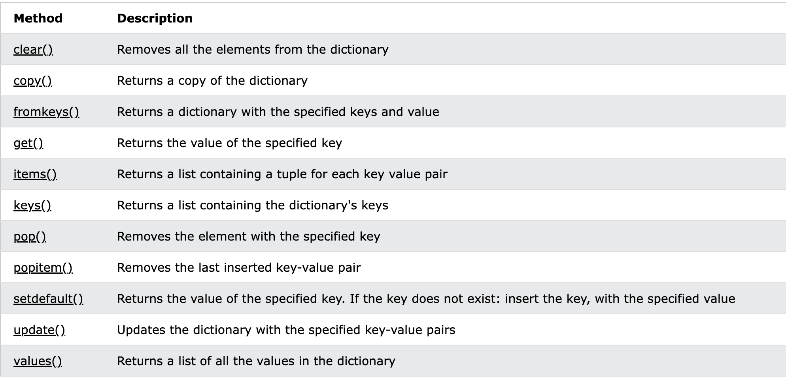
Dictionary methods and properties
Examples for dictionary methods in Python:

Slide 12
Array vs Dictionary
Arrays and dictionaries are two different data structures with different properties and abilities. Arrays:
Can be sorted and keep the order of element
Can have duplicate values in different indexes
Can be access / update / delete by providing the index
Can save only the element itself and the index of this element
Dictionaries:
Order doesn’t matter, can’t maintain the order of key-value pairs and can’t be sorted
Can’t have duplicate keys but can have duplicate values for different keys
Can be access / update / delete by providing the key name
Can save both the key and the value of each key, allow us to save more information in a single data structure

Slide 13
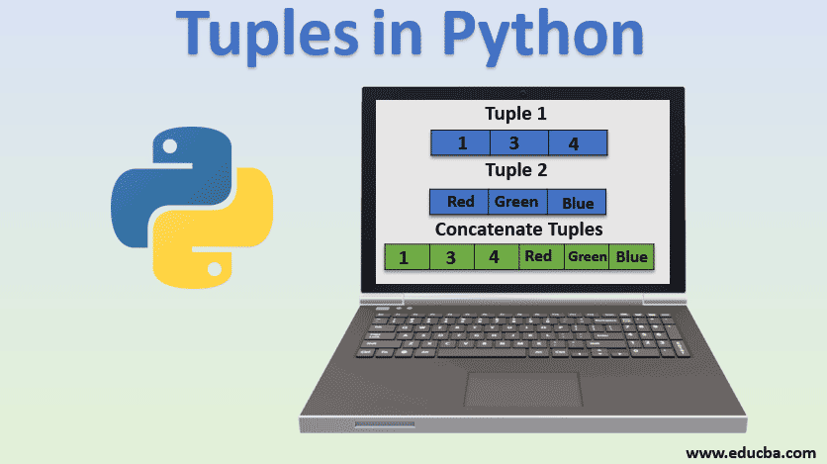

Slide 14
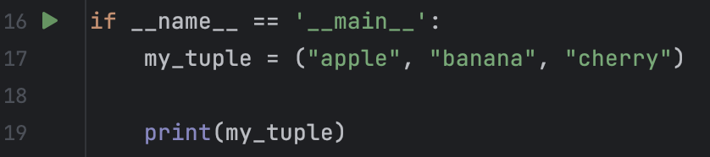

What are Tuples in Python?
Tuples in Python are a type of data structure that is used to store multiple items in a single variable. Tuples are ordered, which means the items have a defined order that will not change, and immutable, which means we cannot change, add or remove items after the tuple is created.
Tuples are written with round brackets (), and items are separated by commas. For example:

Slide 15
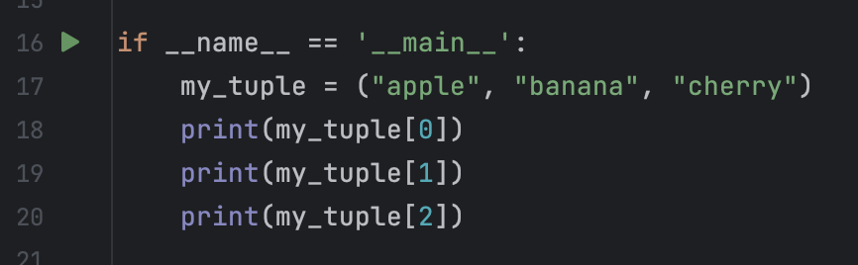
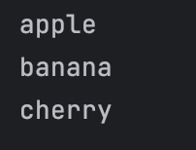
Get specific element in Tuple
Just like with Python arrays, Python tuples also allow us to access to a specific element by providing the element index. For example:
Getting the first element in the tuple by providing the 0 index

Slide 16
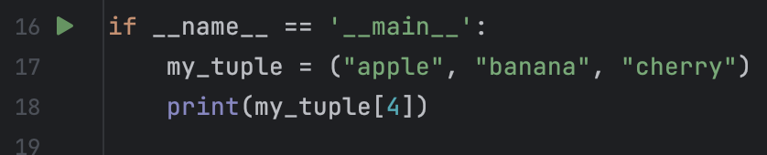
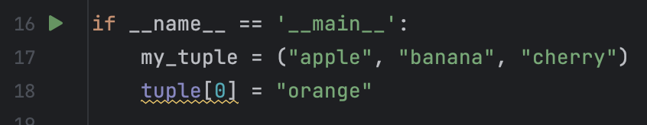
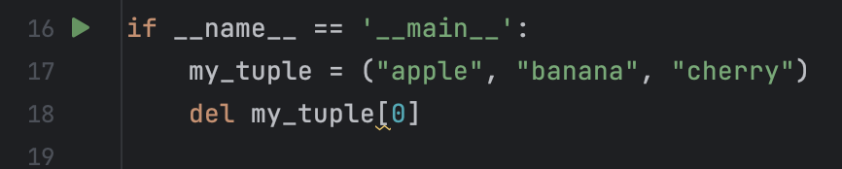
Add / Update / Delete element in Tuple
Unlike Python arrays, in tuple once we create the tuple and provide its elements we can’t change them, we can’t add new element, update existing elements or remove elements from the tuple. This type of data structure called immutable data structure.
Runtime Error

Slide 17
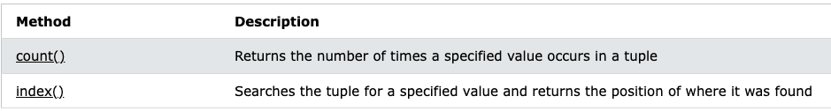
Tuple methods and properties
Examples for tuple methods in Python:

Slide 18
When should we use Tuples?
As we saw tuples in pythons don’t allow us to perform many actions on them once they created, so the question is when should we use this kind of data structure?
Constants: Since tuples are immutable, they are often used to represent a collection of constants, such as days of the week or months of a year.
Data Integrity: If you need to ensure that data does not get modified due to a bug in the code, packaging the data into a tuple guarantees its safety.
Performance: Tuples are generally smaller and faster than lists because of their immutability, so they can be more efficient in performance-critical code.
Dictionaries Key: Since tuples are immutable, they can be used as key in dictionaries, which is not possible with lists.

Slide 19

Class Exercise - Dictionaries & Tuples
Instructions:
Open your Pycharm project and create new Python package called “Python dictionary” Your mission is to implement all the following instructions:
Create a new dictionary represent a course student and provide 5 different key-value pairs as the student properties at your choice (for example first name, last name … )
Write a new function called print_student() that get the student dictionary as parameter and print its entire key - value pairs.
Add to the student 2 new properties called: is_pay_recivied & payment_amount

Slide 20
Class Exercise - Dictionaries & Tuples
Instructions:
Write another function called payment_calculation() that using a global variable called total_payment, the function will get the student dictionary as parameter and check if the is_pay_recivied property is true, if it's true the function will add the payment_amount to the total_payment variable. If the is_pay_recivied no true the function will print “student {student name} didn’t pay yet”.
Create a function the get a tuple of students names with always 4 names inside and a dictionary of student names – student grade as parameters (For example: {“Alon Moshe” : 87})
The function should first check if the tuple is indeed of size 4 and if it does, the function will print for each student name in the tuple its grade from the dictionary. If the student name doesn’t have a grade, the function should notify about it with a print.

Slide 21
Class Exercise - Dictionaries & Tuples Solution

